Slide 1
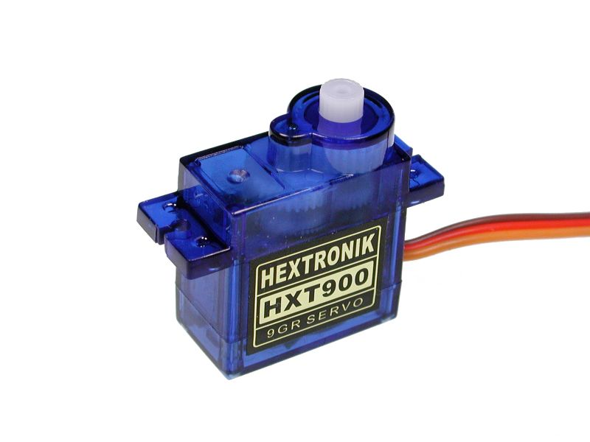

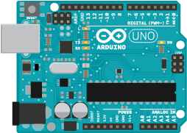



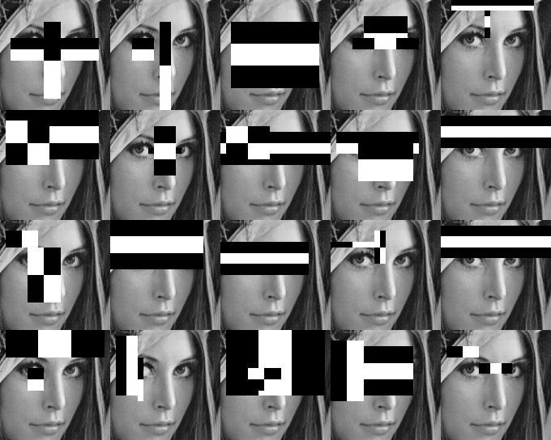


Live Camera
Servo Motors
Face
Arduino Uno
Serial Communication
Image
Processing
Cascade Classifier
Computer
Graphical User
Interface (GUI)

